Slide 1
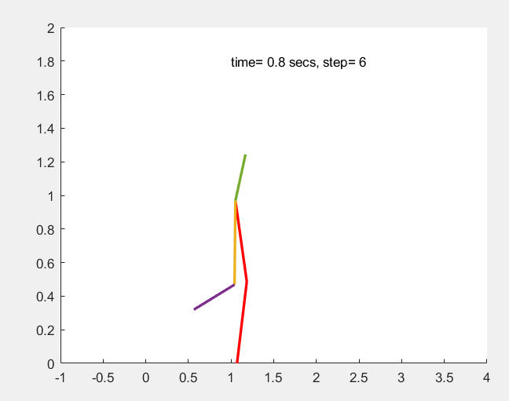
Biped Modelling for 5-link Robot
The image on this title slide option can be replaced.
To replace, delete current image and click the icon to insert a new image.
Delete this box after updating the image.
Presented by:
Hao Xiang Yang
April 14, 2025

Slide 2
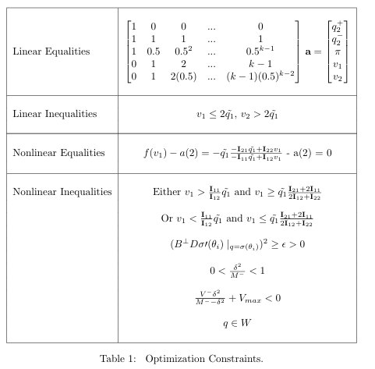
Part 1/Part 2 Results
Controller:
Constraints:
Sometimes fmincon would terminate without meeting all nonlinear constraints

Slide 3
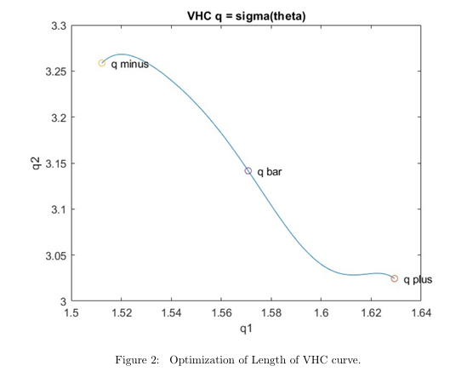
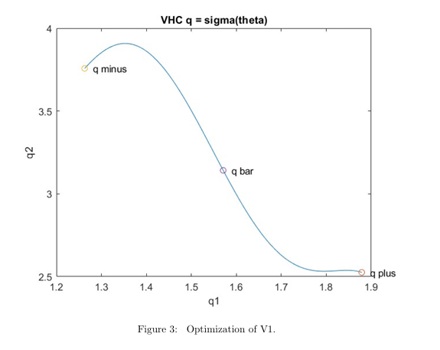
Part 2 Results

Slide 4
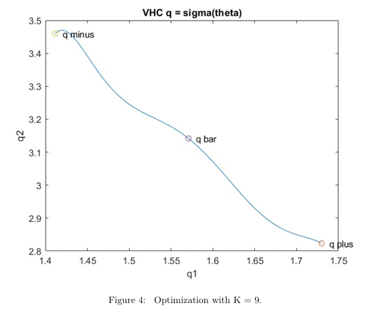
Part 2 Results
Issue with higher order polynomials
Not enough constraints
Acrobot still walks but not inside W safe set

Slide 5
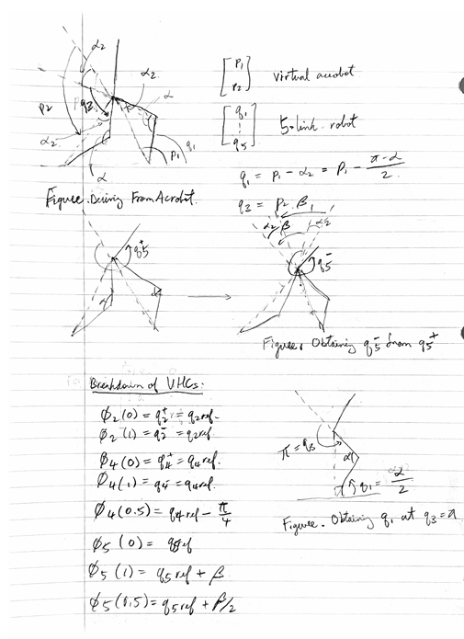
Part 3 – The fun part (5-link Robot)
Idea: model the 5-link robot as an acrobot
Stiff swinging leg and pivot leg
Define constant angle for q2 and q4 for q+ and q-
Constraints
q1,q3 similar to acrobot
q4 is the same at q+ and q-, but decreases in the middle
q5 remains the same relative to the ground

Slide 6

Part 3
Assign design parameter alpha and q_ref
Set up q+ and q- just like the acrobot
Set up VHC for each q’s and solve for polynomials

Slide 7
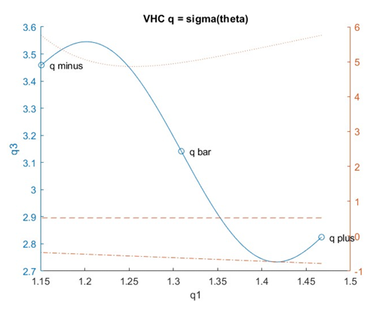
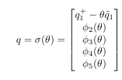
Part 3

Slide 8

Part 3
Shortcomings
Does not pass hybrid limit set conditions
v1,v2?
According to my animations, the robot seems to settle on a limit cycle
Stumble near step=5
Possible unstability at N>>1
Limit cycle is asymptotically stable?
Future work

Slide 9
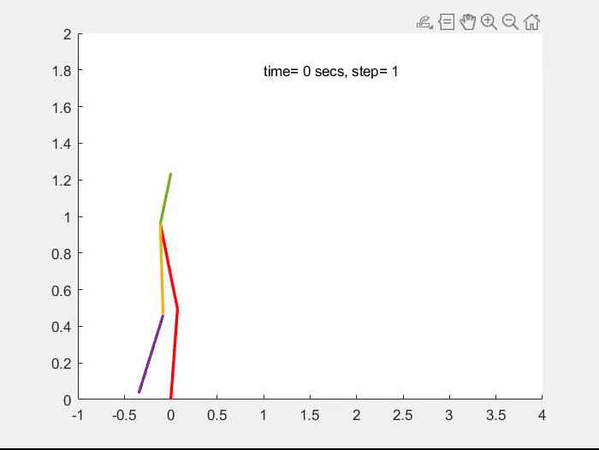
Part 3 Video

